Slide 1
GULFMET Update to the RLMO Round Table
Eng. Ameena Zainal
TC Legal Chair
RLMO Interim Round Table Meeting- Sept 27, 2022

Slide 2
Overview of significant developments and activities during the past year in the GULFMET
OIML certification system (CS) Committee::
GULFMET has nominated
Mr. Nawaf Al Shamari ( Saudi Arabia)
Eng. Salam Al Heyari ( UAE)
For the membership of the OIML CS Management Committee
GULFMET TC legal had formed a Work Group,
GULFMET WG has reviewed and updated the GCC Common Metrology law and raised it for approval by the Ministerial Committee.

Slide 3
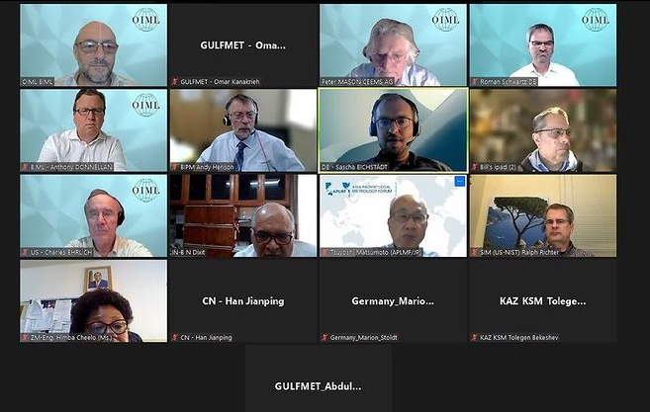
Overview of significant developments and activities during the past year in the GULFMET
3. OIML CEEMS Advisory Committee meeting July 21, 2022
GULFMET has participated online in the meeting

Slide 4
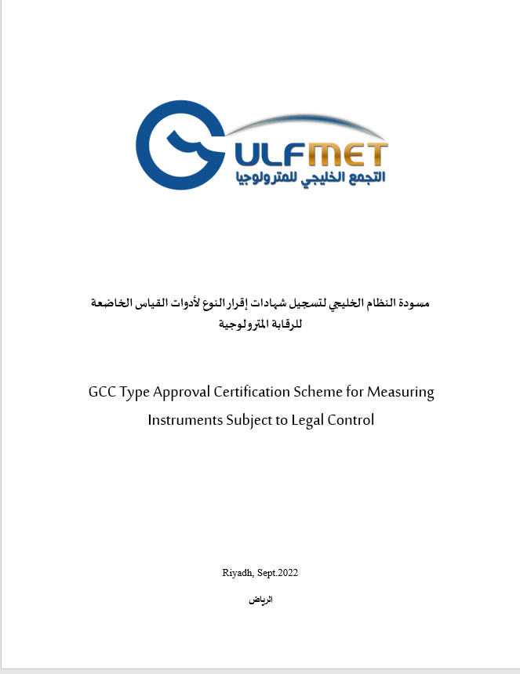
Overview of most urgent technical and other legal metrology issues in the region during the past year in the GULFMET
GULFMET WG has completed the proposal to Introduce the GCC certification Scheme based on OIML CS

Slide 5
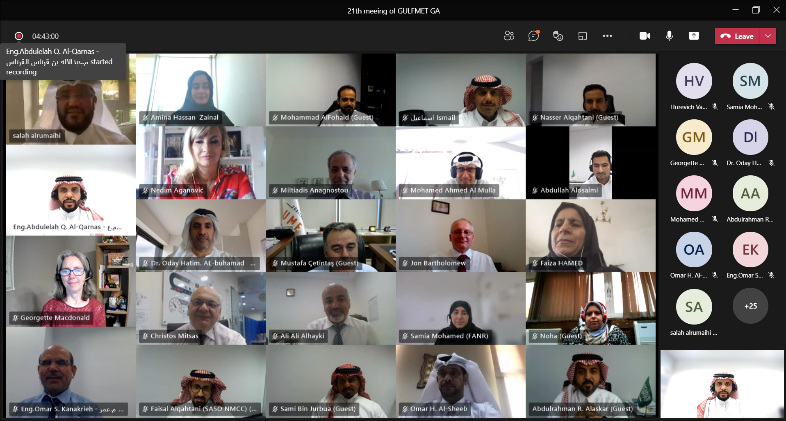
Anticipated calendar of events for the coming year in the GULFMET
Last events
- GULFMET TC legal ( December. 6th, 2022 )
- GULFMET Week Events (December. 12 -15, 2022 )

Slide 6
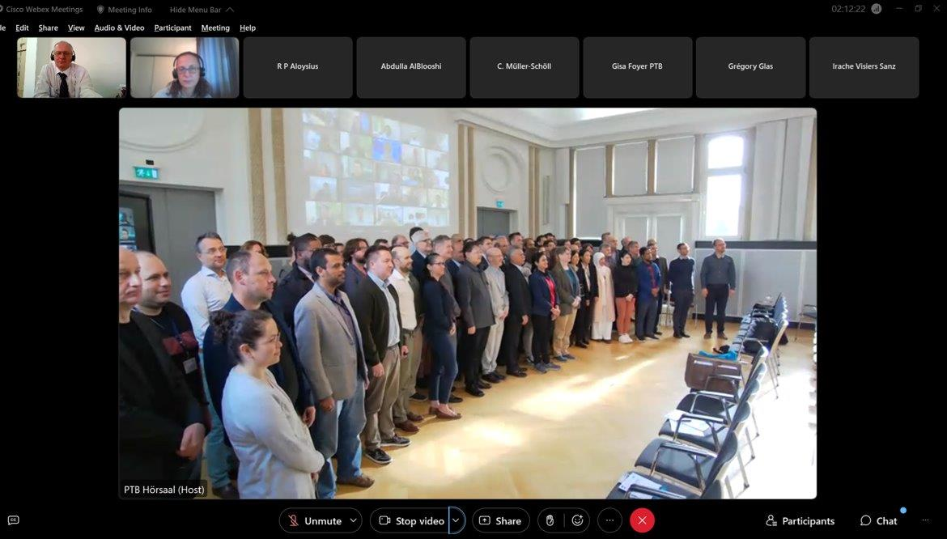
Comments on RLMO discussion topics for this year
Discussion Topic:
How is your RLMO approaching ‘digitalization’ pertaining to measuring instruments in your region?
Existing elements:
. IMEKO conference on Metrology and Digital Transformation:
GULFMET has participated physically in the conference which was held in Berlin – Germany 19-21 Sept. 2022 and benefits from the scientific papers that were presented.

Slide 7
Summary/Concluding remarks
GULFMET is keen on the following issues:
Harmonization of metrological legislation by getting GCC Common metrology law updated and approved.
Enhance the technical capabilities be identifying the training needs
Introduce GULFMET Capacity Building and Knowledge Transfer Programme.
Recommending the formation of a type approval and registration team for measuring instruments subjected to metrological control.

