Slide 1

COOMET
Update to the RLMO Round Table
Yuriy Kuzmenko, COOMET TC2 Legal Metrology Chair
RLMO Round Table meeting - September 30, 2021

Slide 2
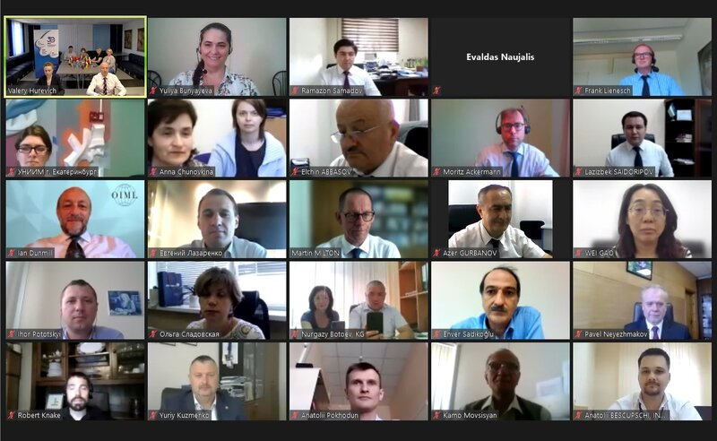
Overview of significant developments and activities during the past year in the RLMO
31st COOMET Committee meeting (15-17 June 2021, online)
Main results:
New members of COOMET Presidential Council for 2021-2023 were approved.
Online surveys to assess the effectiveness of work of CSBs among COOMET Committee members and CSB members have been organized (June - October 2021). Collection of the information and processing of the results are currently in progress.
The COOMET criteria for member countries to be classified as CEEMS were adopted:
lack of the status of the "Member of the Metre Convention" or "CGPM Associate" of the country;
lack of published CMC entries;
non-participation in key or supplementary comparisons, registered in the KCDB.
A survey was initiated among COOMET Committee members to define the positions of COOMET member countries on the issues concerning the possible change of the institutional status and criteria for membership in COOMET, issues of funding of COOMET activities. Collection of the information and processing of the results are currently in progress.
32nd extraordinary online
COOMET Committee Meeting
26 October 2021
A set of issues on changing the institutional status of COOMET and funding of activities (taking into account the results of survey) will be discussed.

Slide 3
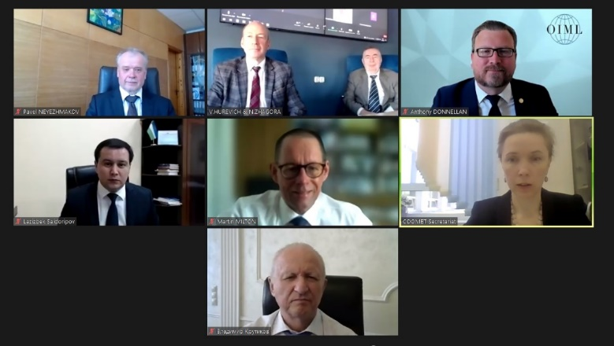

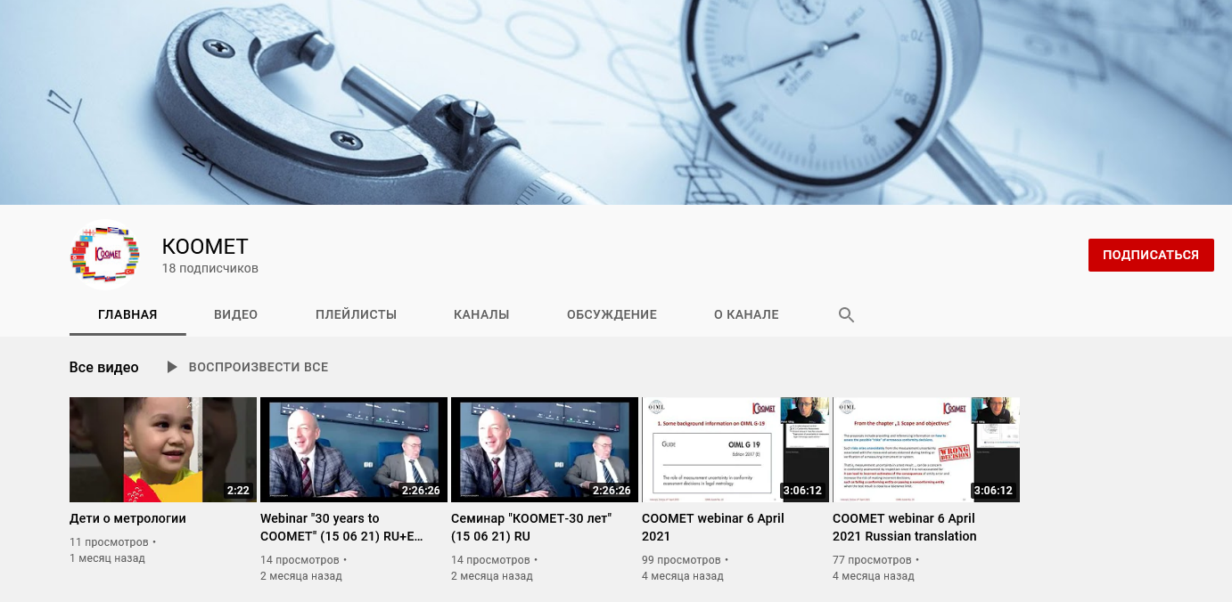
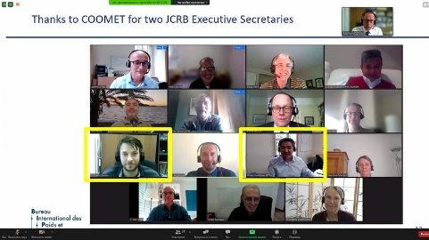
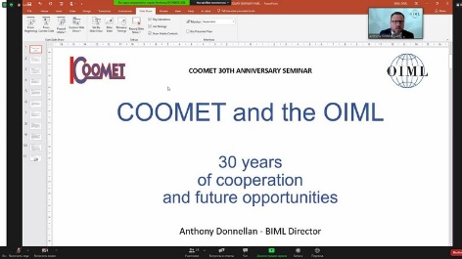
Overview of significant developments and activities during the past year in the RLMO
Webinar "30 years to COOMET" (15 June 2021, online)
Date of COOMET’s establishment:
On 12 June 1991 in Warsaw representatives of national metrology organizations of five countries: Bulgaria, Poland, Romania, the USSR and Czechoslovakia signed the COOMET Memorandum of Understanding.
The recording of the webinar is available on the official YouTube channel of COOMET.
https://www.youtube.com/channel/UCyqRp_86A8lQZXMNonkd11g
80 specialists from 15 countries (Azerbaijan, Armenia, Belarus, Germany, Georgia, Kazakhstan, China, Kyrgyzstan, Lithuania, Moldova, Russia, Slovakia, Tajikistan, Uzbekistan, Ukraine) took part in the webinar, as well as representatives of the EURAMET and EASC

Slide 4
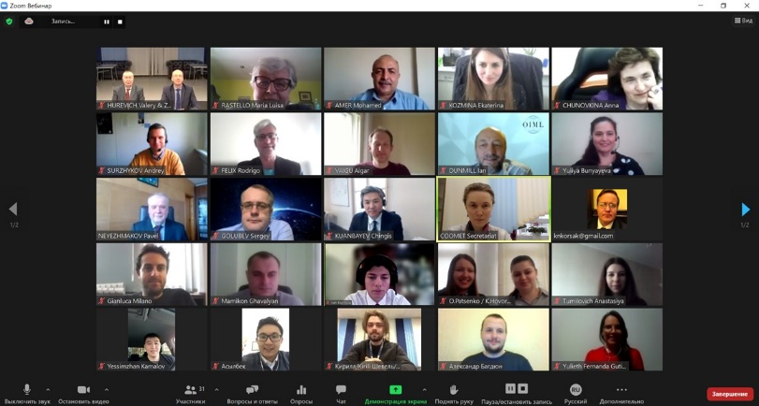
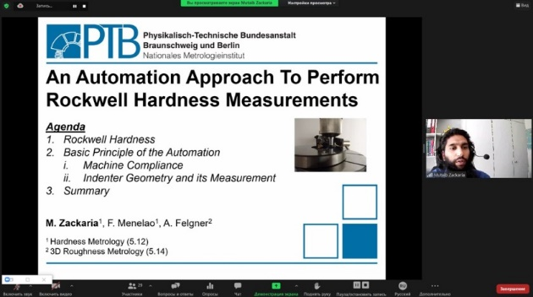
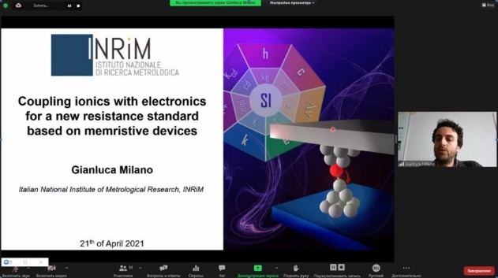
Overview of significant developments and activities during the past year in the RLMO
IX International Competition "The Best Young Metrologist of COOMET-2021"
(21-22 April 2021, online)
This year representatives of other regional metrology organizations joined the competition.
In total, there were 18 papers submitted from: COOMET (Belarus, Kazakhstan, Germany, Russia, Ukraine), EURAMET (Italy) and SIM (Colombia, Mexico).
After careful and objective consideration the members of the Scientific Committee defined the winners of the competition:
Gianluca Milano (EURAMET, INRIM, Italy)
for the best report in the field of scientific and fundamental metrological activity;
Mutaib Zackaria (COOMET, PTB, Germany)
for the best report in the field of applied metrological activity.
Next Competition - 2023

Slide 5
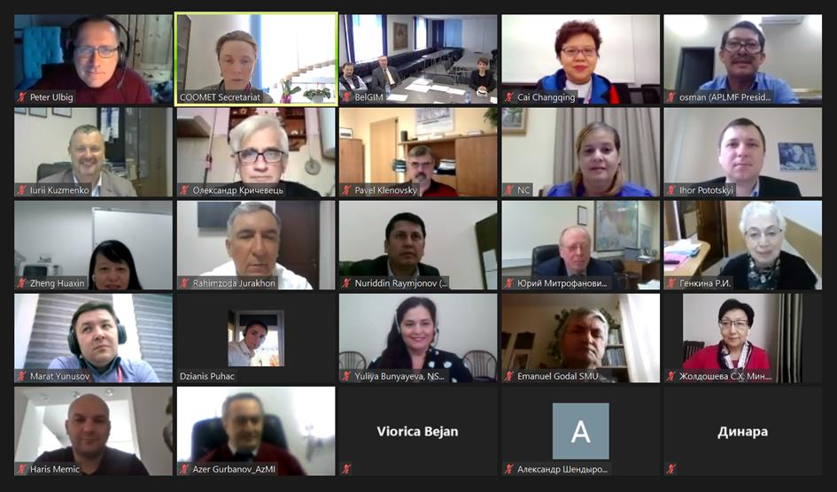
Overview of most urgent technical and other legal metrology issues in the region during the past year in the RLMO
COOMET TC 2 “Legal Metrology”
21st TC 2 meeting has taken online on
7-8 April 2021
WITH
WELMEC and APLMF CHAIRS
Next meeting online
27-28 September 2021

Slide 6

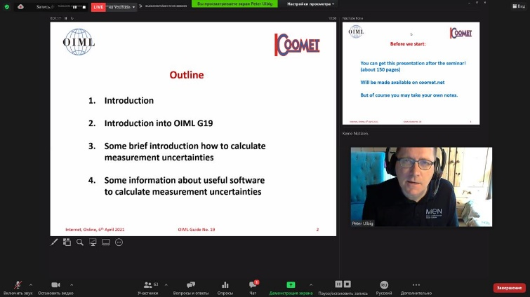
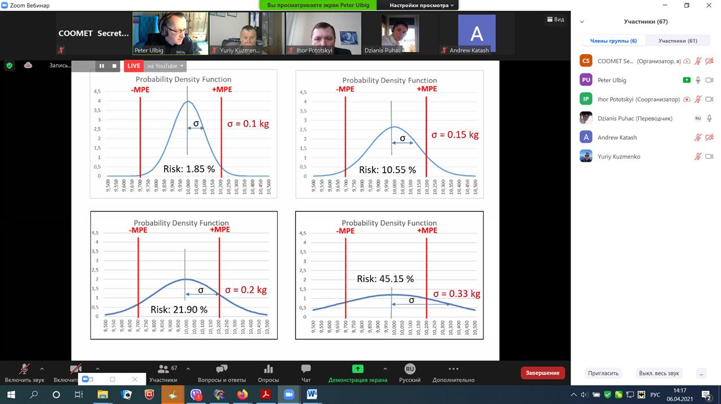
COOMET TC 2 “Legal Metrology”
COOMET webinar “The role of measurement uncertainty in conformity assessment decisions in legal metrology” (6 April 2021, online)
Excluding the subcommittees from the structure of TC2
Direction |  | Coordinator
Measuring devices in the field of LM |  | BelGIM, Belarus
Measuring systems in the field of LM |  | «Systema», Ukraine
Medical equipment with measuring functions |  | UzNIM, Uzbekistan
Conformity assessment of MI |  | Ukrmetrteststandart, Ukraine
Digitalization in LM |  | MEN, Germany
More than 100 representatives of NMIs/DIs of COOMET member countries (Azerbaijan, Armenia, Belarus, Bosnia and Herzegovina, Germany, Kazakhstan, Kyrgyzstan, Moldova, Russia, Slovakia, Tajikistan, Turkey, Ukraine, Uzbekistan) took part in the seminar.

Slide 7
Tasks of COOMET TC 2 “Legal Metrology” for 2021
TOP 12 for translation
Translation of the Brochure UNIDO-OIML "Certification of measuring instruments"
Translation of Document OIML D1:2020
Translation of D10, D11, D30, D31, D32, D33, R75, R125, R137, G14
Updating COOMET Recommendations
R/LM/28:2016 "Typical test program for software of measuring instruments"
R/LM/8:2002 "Construction, presentation, design and content of the Type description of the of measuring instrument for the national register of measuring instruments“
R/LM/25:2015 "Procedure for recognizing technical devices as measuring instruments"
R/LM/26: 2015 "General requirements for the competence of verification laboratories"
Drafting of a list
of accepted rules, guidelines, recommendations in the field of legal metrology of other RLMOs of interest to COOMET countries, and agreement on the possibility of their application in COOMET member countries

Slide 8
Anticipated calendar of events for the coming year in the RLMO
32nd extraordinary COOMET Committee meeting (26 October 2021, online);
COOMET webinar "The practice of implementation of the documents of the CIPM MRA and COOMET publication on carrying out and evaluation of results of calibration and comparison" (15 October 2021, online);
COOMET training webinar on "Metrology of stable isotopes"
(during the TC 1.8 meeting: 28-29 October 2021, online);
COOMET webinars "The practice of implementation of the CIPM MRA documents regulating the activities of NMIs on the procedure for СМС preparing and calculation of the uncertainty budget"
for interested TCs (jointly with the TC meetings, autumn 2021, online);
Workshop on digital transformation in metrology for young COOMET metrologists (autumn 2021, online).

Slide 9
Comments on RLMO discussion topics for this year
Discussion Topic:
How is your RLMO approaching ‘digitalization’ pertaining to measuring instruments in your region?
Established COOMET WG “Digitalization in metrology”
In accordance to Agenda of the next TC2 meeting (online,
27 September 2021) expected brainstorming and information exchange about current level of digitalization in member countries
Next steps in LM – Coordinator of Direction Digitalization in LM
Peter Ulbig

Slide 10

Summary/Concluding remarks
COOMET TC2 intend:
Work in close cooperation with other RLMO and consistently use the best practices of colleagues
Together with COOMET TC4 "Information and Training" to develop training in the field of LM
Promote and support the development of the OIML CS system in COOMET member countries

